Slide 1
UI / UX
Presented by,
Araniga S.M
Roll No : 08

Slide 2
What is ui ?
UI stands for User Interface
UI means what the user looks and feel while using an app
Example:
Icons
Buttons
Texts
Colours
Images

Slide 3
UI example : YOutube
The following are the UI of YouTube:
Search icon
Bell icon
Youtube logo
Navigation bar
Buttons [Like, Comment, Share etc ….]

Slide 4
What is ux?
UX stands for User Experience
UX means what a user experience while using an app
Example:
Is it good to use?
Is it simple?
Is it easy to find?
Can the user understand?

Slide 5
Ux example : watching a movie
For example : To watch a movie
Open the app
Search for the movie to watch
Select the movie
Can comment about the movie
Can share it with anyone

Slide 6
UI / ux - difference
UI | UX
User Interface | User Experience
Visual Design | Overall Experience
Buttons | User Satisfaction
Make screen attractive | Makes app useful and easy to use
Images | User trust
Layout | Research

Slide 7
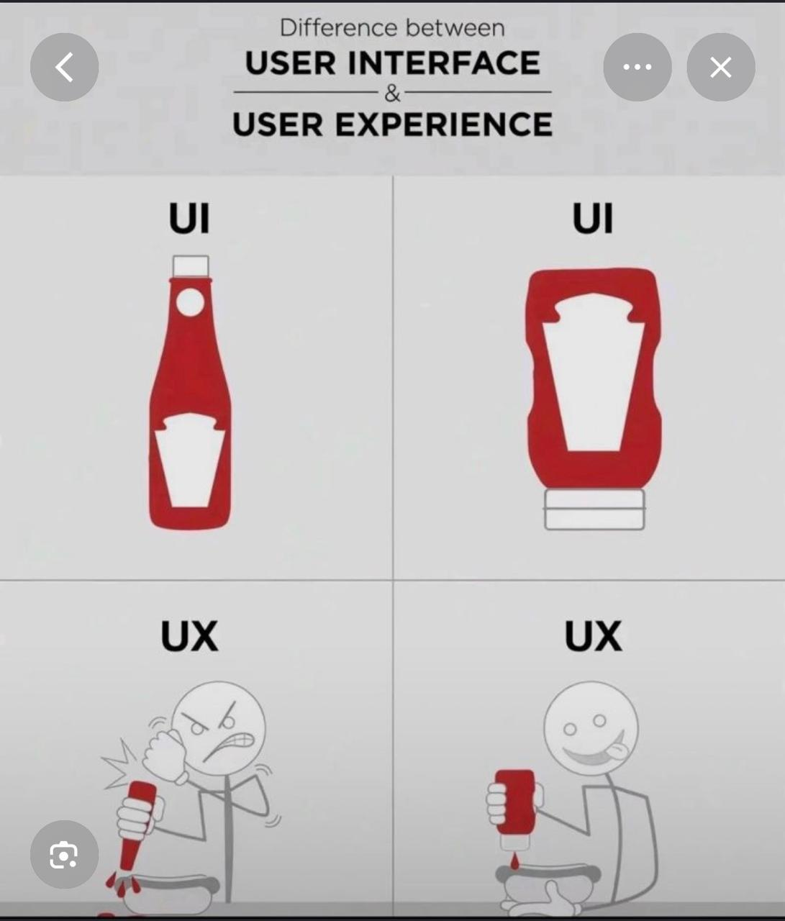
Ui / ux - example

Slide 8
Thank you

